Slide 1
Sat vocabulary 23
Download “Dictionary.com” app on IPhone/Android. It will be especially helpful for vocabulary study.
As we go through the slides, fill in the necessary blanks on your chart. You are responsible for filling in missing information.

Slide 2
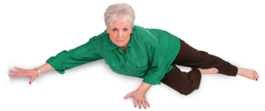
1. ambulatory AM bew luh tor ee
Part of Speech-
Definition- able to walk or move around
Synonym-
Antonym- bedridden, stiff, settled
Sentence-

Slide 3
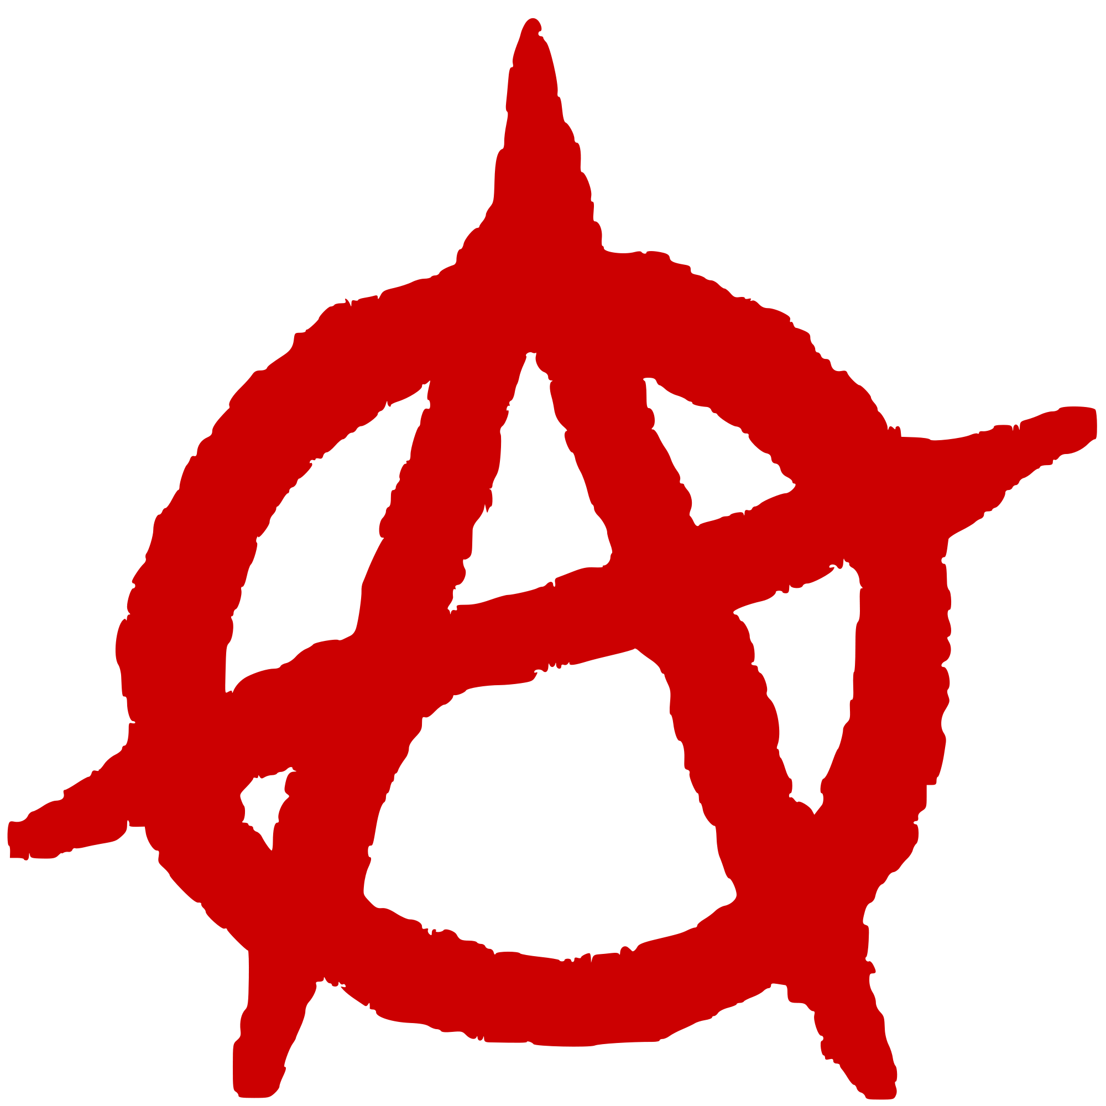
2. Anarchy AN ar kee
Part of Speech-
Definition-
Synonym- chaos, disorder, rebellion
Antonym-
Sentence- During the revolution, the government was overthrown and the country was in a state of anarchy.

Slide 4
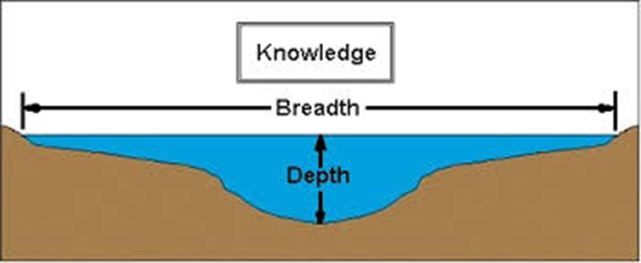
3. breadth BREDTH
Part of Speech-
Definition-
Synonym-
Antonym- narrowness
Sentence- The breadth of his knowledge about art is amazing.

Slide 5
4. Cant KANT
Part of Speech-
Definition- secret jargon or slang
Synonym-
Antonym-
Sentence- The rites of the Masons are characterized by their cant.

Slide 6
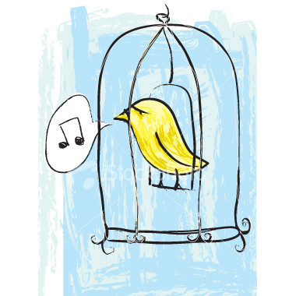
5. circumscribed SIR kum skribd
Part of Speech-
Definition- restricted or limited
Synonym- confine
Antonym-
Sentence-

Slide 7
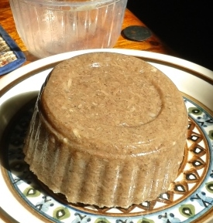
6. congeal kun JEEL
Part of Speech-
Definition-
Synonym-
Antonym- to become fluid
Sentence- We waited three hours for the Jell-O to congeal.

Slide 8
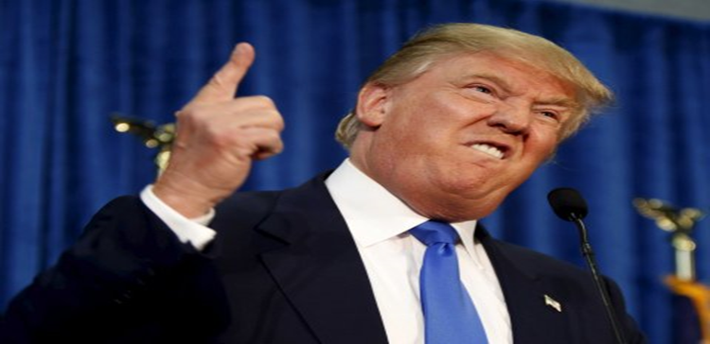
7. demagogue DEM uh gog
Part of Speech-
Definition- a person or leader who appeals to passions or prejudices
Synonym-
Antonym-
Sentence- Hitler is an example of a demagogue who claimed power by appealing to people’s emotions and prejudices.

Slide 9
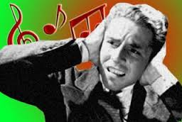
8. dissonance DIS uh nuns
Part of Speech-
Definition- unrelated and harsh combination of sounds
Synonym-
Antonym- harmony
Sentence- Dissonance is a part of some contemporary music.

Slide 10
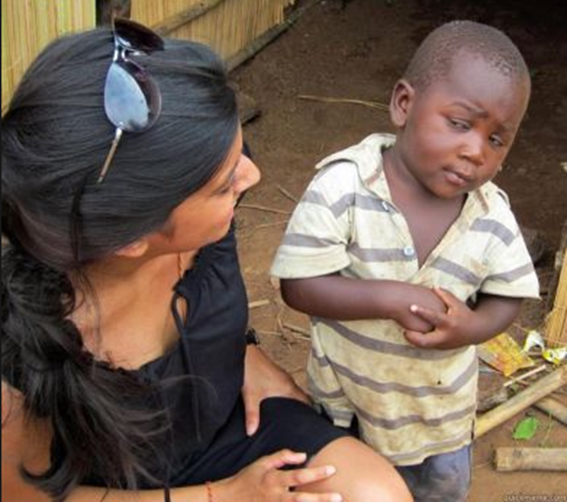
9. dubious DOO be us
Part of Speech-
Definition- doubtful; not clear
Synonym-
Antonym- distinct, doubtless, assured
Sentence-

Slide 11
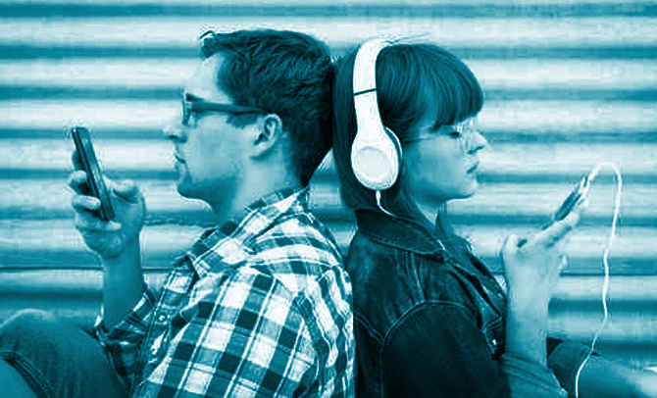
10. engrossed en GROSD
Part of Speech-
Definition- completely occupied or absorbed
Synonym- preoccupied
Antonym-
Sentence-

Slide 12
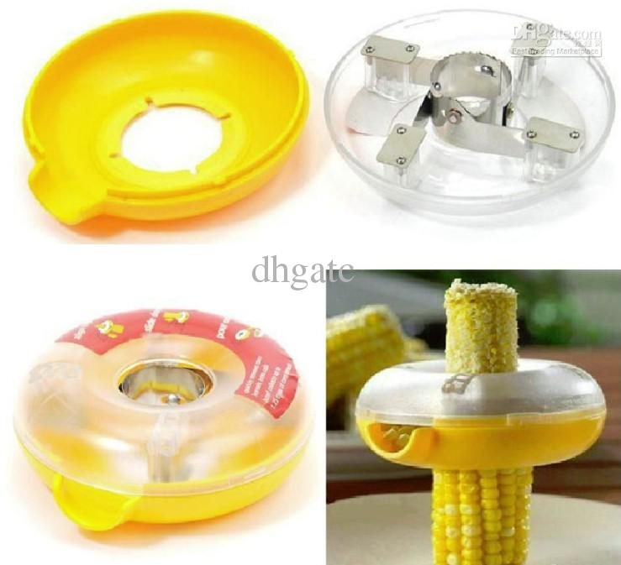
11. facilitate fuh SIL eh tate
Part of Speech-
Definition-
Synonym- ease, help, expedite
Antonym- to complicate
Sentence-

Slide 13
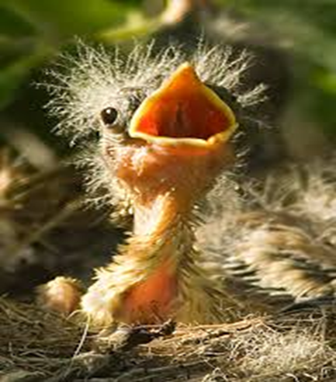
12. fledgling FLEJ ling
Part of Speech- noun
Definition-
Synonym-
Antonym- veteran
Sentence- The rookie policeman is just a fledgling compared to the captain.

Slide 14
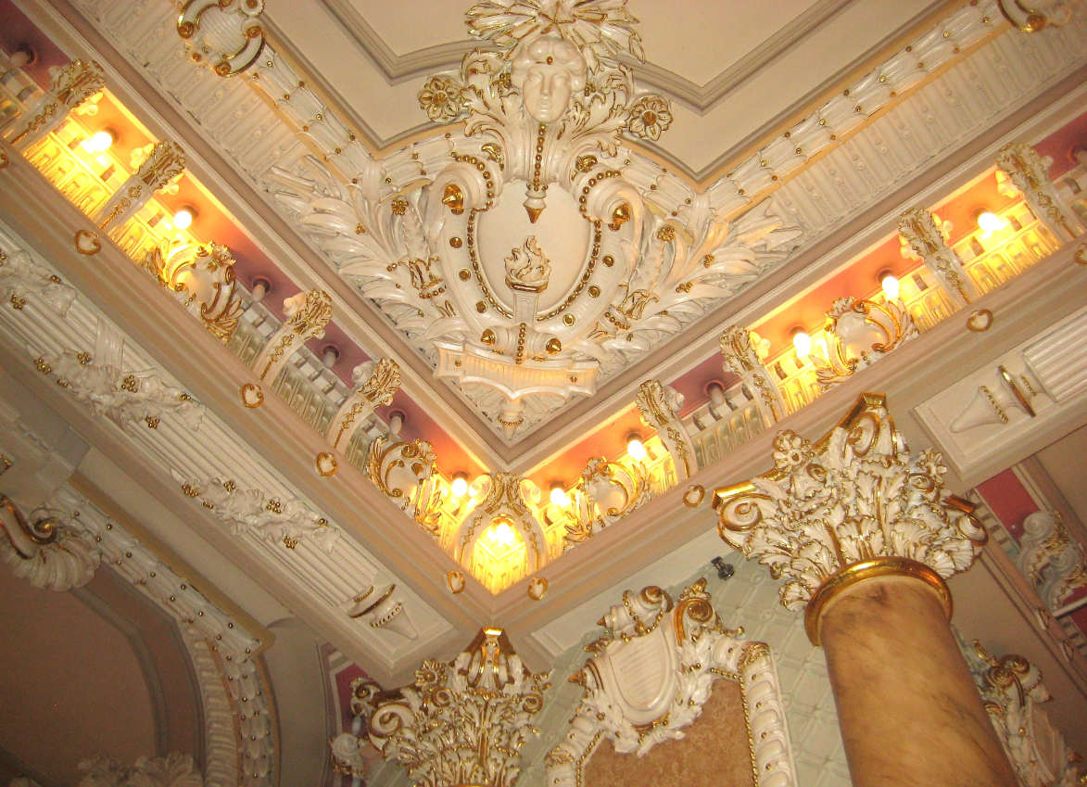
13. gilded GIL did
Part of Speech-
Definition- covered with gold or a golden color; having a background of wealth
Synonym- prosperous, luxurious
Antonym-
Sentence-

Slide 15
14. graphic GRAF ik
Part of Speech-
Definition- vivid
Synonym- descriptive
Antonym- simple
Sentence-

Slide 16
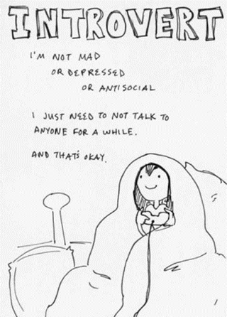
15. introvert IN truh vurt
Part of Speech- noun
Definition-
Synonym-
Antonym- extrovert
Sentence-

Slide 17
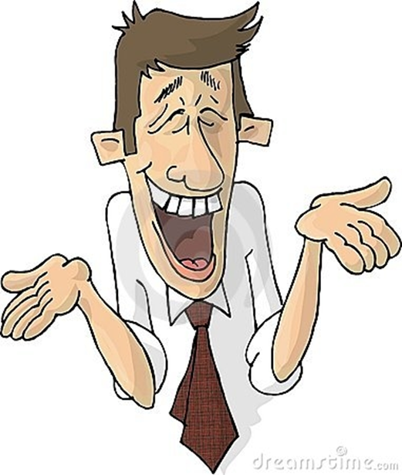
16. jocular JOK yu lur
Part of Speech-
Definition-
Synonym- facetious
Antonym- serious
Sentence- The man's jocular
mood kept us all entertained
throughout the evening.

Slide 18
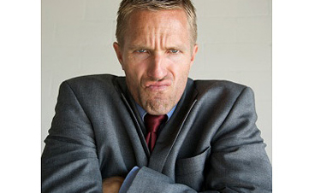
17. malcontent MAL kun tent
Part of Speech- noun
Definition- a person who is constantly dissatisfied and discontented
Synonym-
Antonym-
Sentence-

Slide 19
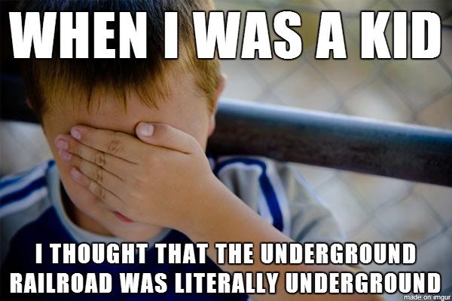
18. Misnomer mis NO mur
Part of Speech-
Definition- misnaming, use of a wrong name
Synonym-
Antonym-
Sentence-

Slide 20
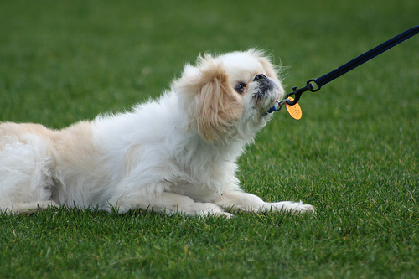
19. obstinate OB stuh nit
Part of Speech-
Definition-
Synonym-
Antonym- yielding
Sentence-He will not accept advice on many things because of his obstinate attitude.

Slide 21
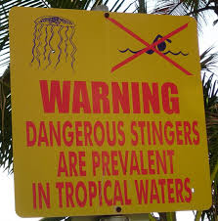
20. prevalent PREV uh lunt
Part of Speech-
Definition- generally or widely accepted, current, or practiced
Synonym- prevailing, victorious, dominant
Antonym-
Sentence-

Slide 22
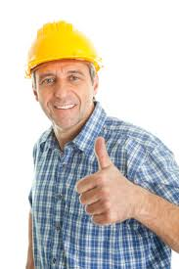
21. prudent PROOD unt
Part of Speech-
Definition- wise and careful about practical matters
Synonym-
Antonym- indiscreet; incautious
Sentence-

Slide 23
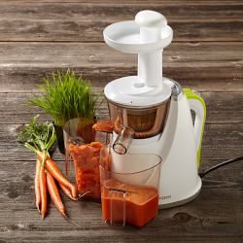
22. pulverize PUL vuh rize
Part of Speech-
Definition-
Synonym-
Antonym- to mold together
Sentence- The rocks were pulverized by the heavy machine rolling over them.

Slide 24
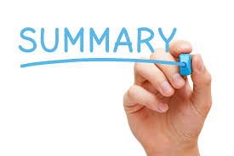
23. recapitulation ree kuh pich uh LAY tion
Part of Speech-
Definition- a summary
Synonym-
Antonym-
Sentence-

Slide 25
24. steadfastness STED fas nes
Part of Speech- noun
Definition-
Synonym-
Antonym-
Sentence- The steadfastness of her position not to sell her land is remarkable considering what she has been offered.

Slide 26
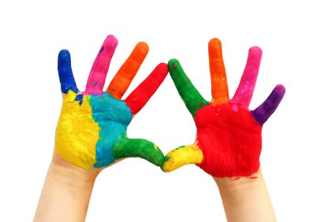
25. tactile TAK til
Part of Speech-
Definition-
Synonym- tangible
Antonym- intangible
Sentence-

